Slide 1

Remote Sensing of Harmful Algae
Developed by Max Beal and Dr. Paul Block
University of Wisconsin-Madison

Slide 2
Outline
Algae and Water Quality
Causes of harmful algal blooms and impacts
Remote sensing of surface waters
What is Remote Sensing?
Electromagnetic radiation
Reflection, transmittance or absorption
Activity
Develop statistical model to estimate chlorophyll-a from camera imagery

Slide 3




Algae and Water Quality
Harmful algal blooms (HABs) are increasingly recognized as a water quality issue across the U.S.
HABs often occur in surface waters that have experienced high nutrient pollution
Rapid growth of algae can have a range of negative consequences for communities living near impacted waters
Taste and odor issues creating loss in property value
Production of toxins dangerous to humans
Negative impacts on ecosystem services

Slide 4
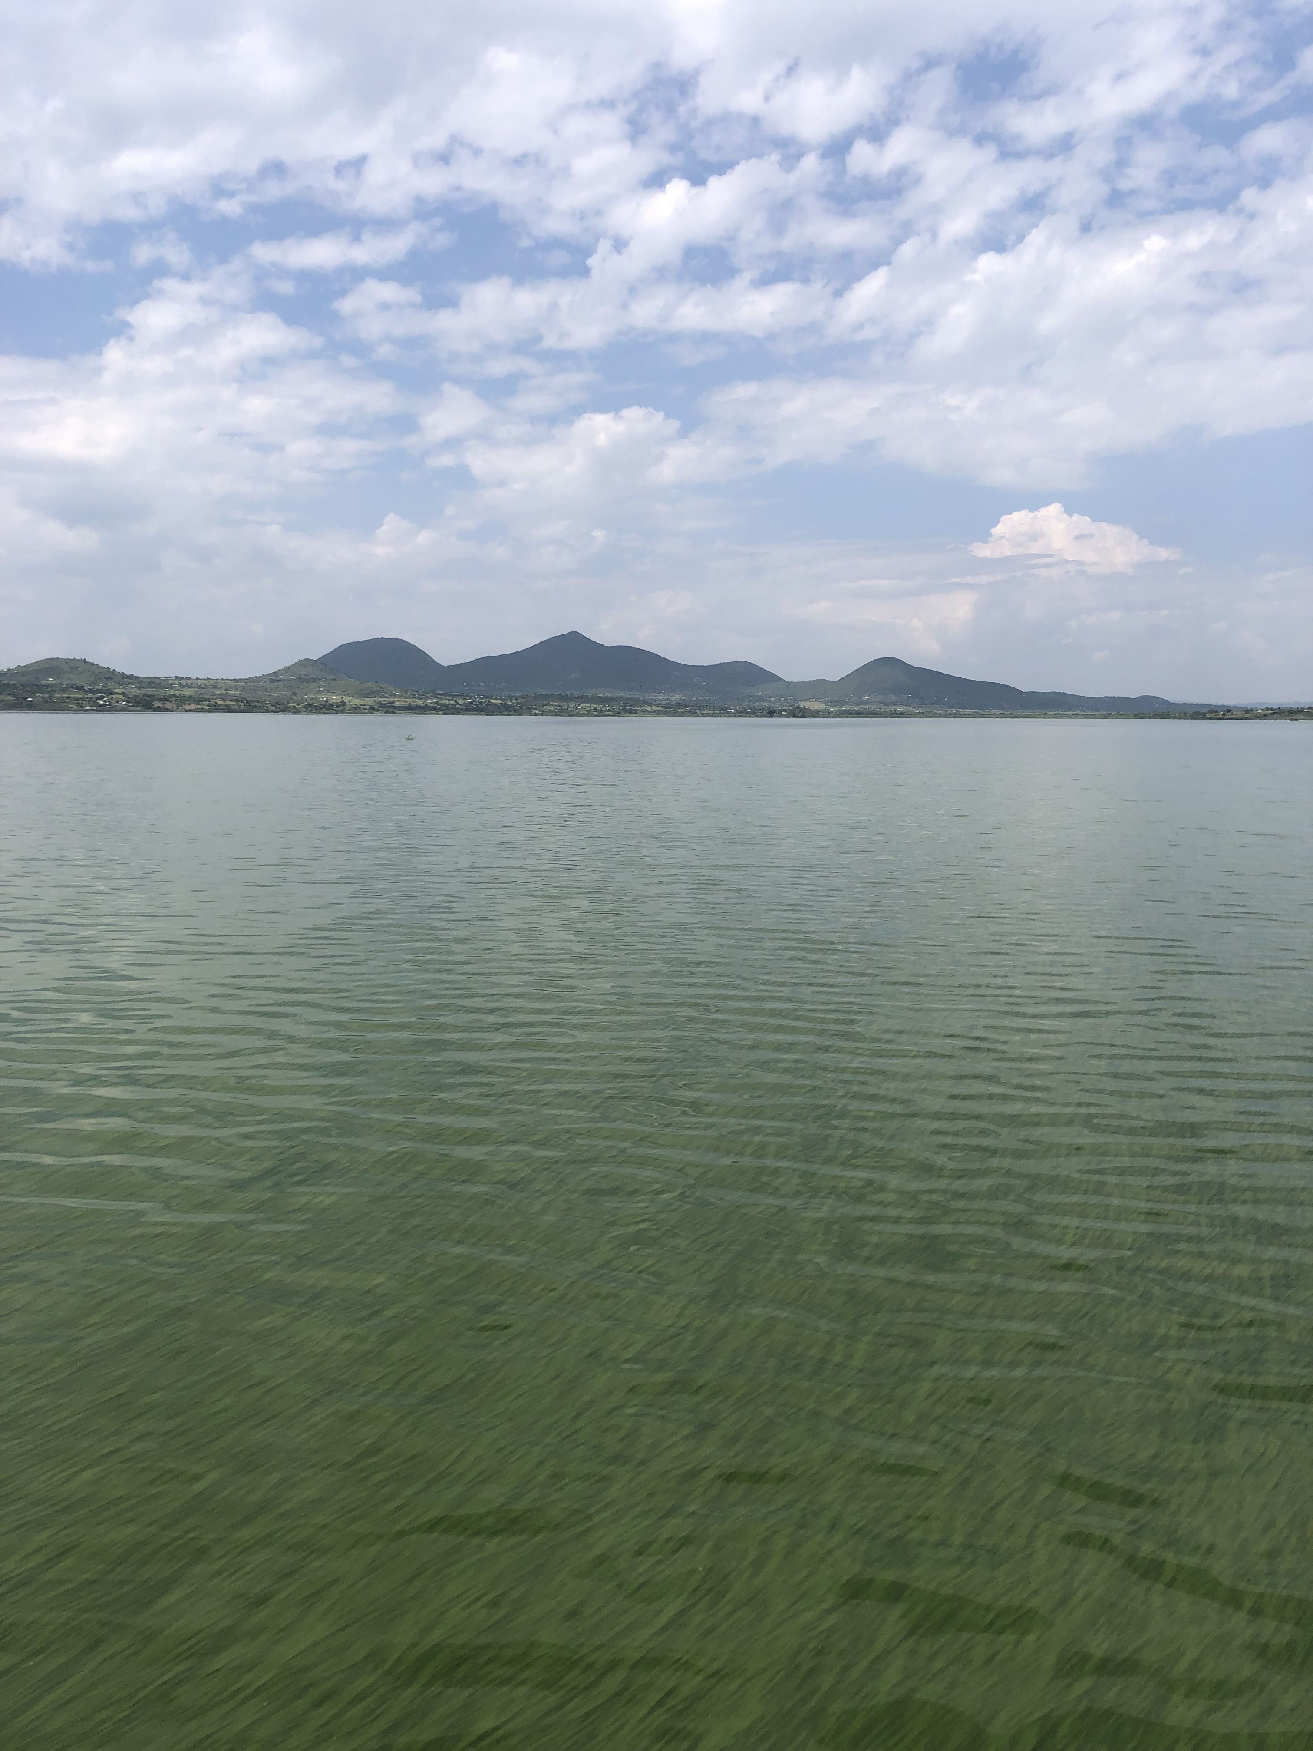
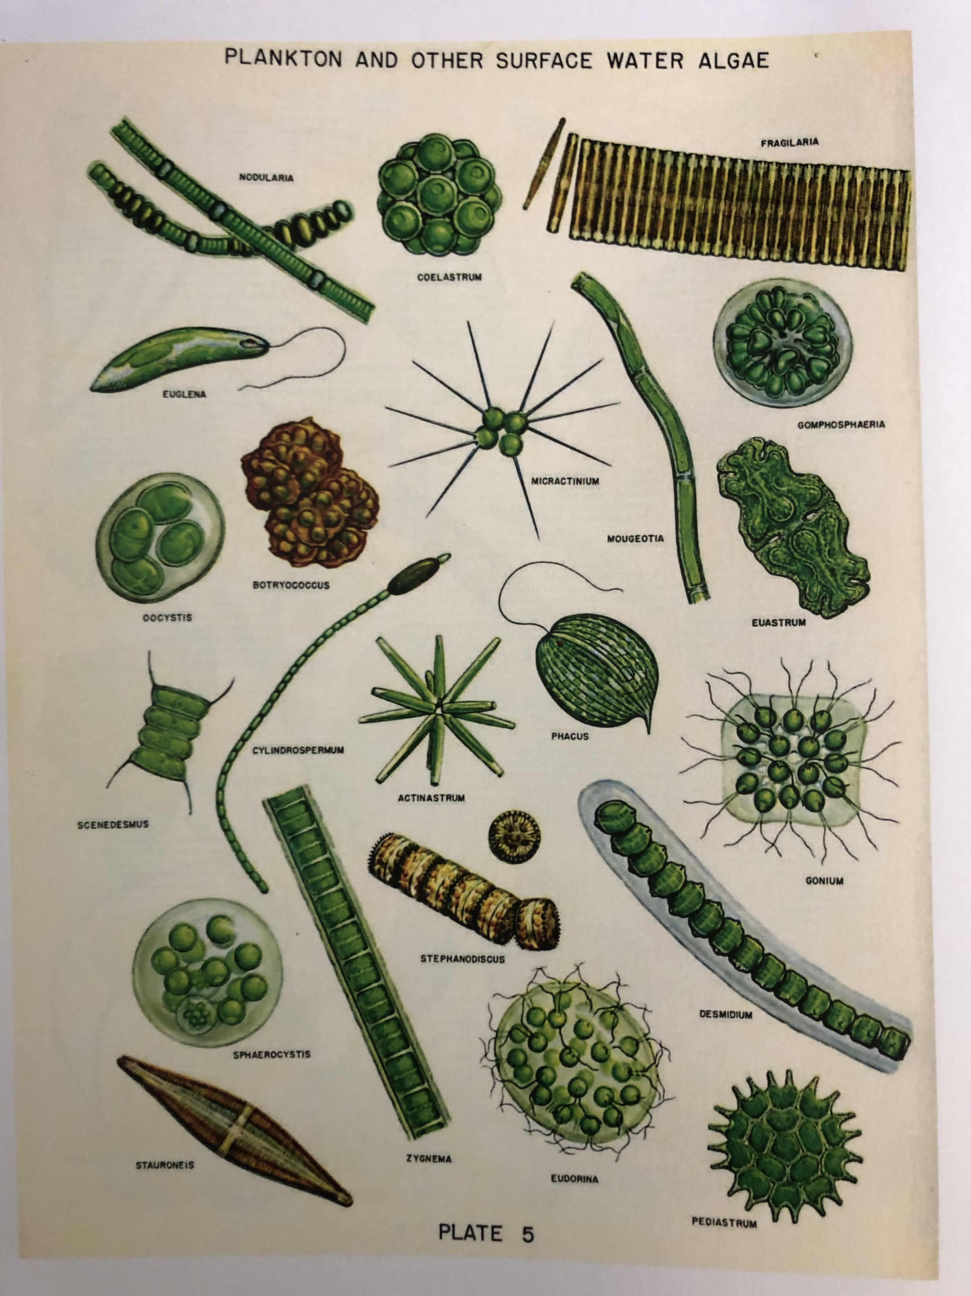
High abundance of algae changes the color of the water. Many algae species have high concentrations of the pigment chlorophyll-a
Algae species
Palmer, 1959

Slide 5




Remote Sensing
The measurement of information at a distance
Remote sensing often makes use of emitted or reflected electromagnetic radiation
Electromagnetic energy travels in waves with different wavelengths

Slide 6
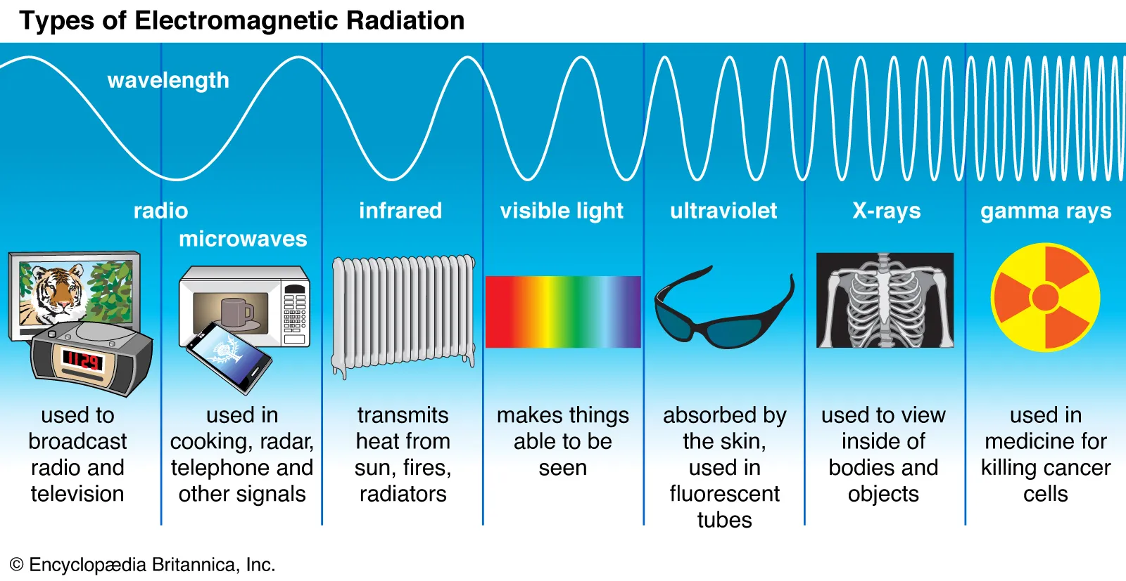

Electromagnetic radiation
All energy from the Sun that reaches Earth arrives as solar radiation
Solar radiation is electromagnetic radiation emitted by the sun
Visible light is solar radiation that can be seen by the human eye.
This is the kind of light our phones capture when they take photos (~400-700 nm)

Slide 7
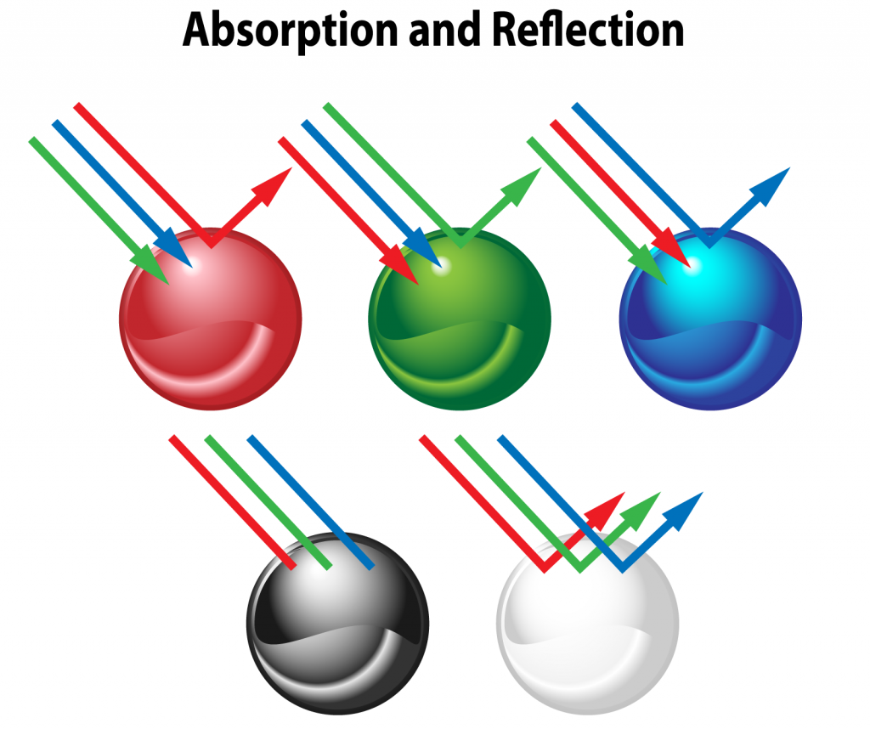

Solar radiation can be reflected, transmitted or absorbed by a medium.
The properties of a medium influence which kinds of radiation are reflected, transmitted, or absorbed. This changes how an object looks to the human eye.
Using cameras, we can quantify how much light of each wavelength is reflected
color-meanings.com

Slide 8

Using satellite imagery and water quality data we can create mathematical relationships between reflectance and chlorophyll-a to monitor algae abundance

Slide 9
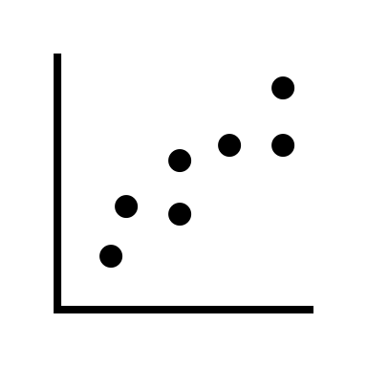
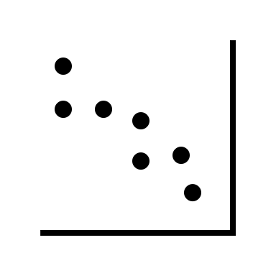
We will create a statistical model to predict chlorophyll-a using reflectance data
What do we expect to happen?
Chlorophyll-a
Green reflectance
Red reflectance
Blue reflectance

Slide 10
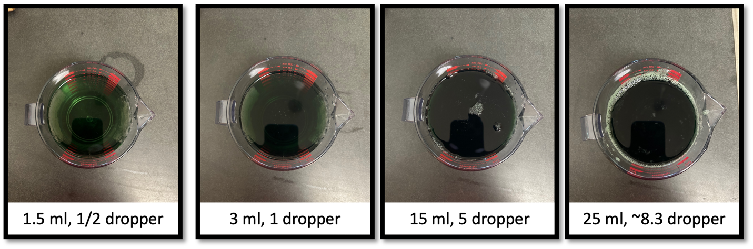
Activity
Use camera imagery and water quality samples to develop a model for monitoring algae abundance in surface waters
1.5 ml
3 ml
15 ml
25 ml

Slide 11
Activity
Step 1: Go to https://tinyurl.com/MendotaRS
Log into a google account
Go to >File >Save a copy in Drive
Open your saved copy of the Mendota workbook
Step 2: Mix four chlorophyll samples in the provided cups, following the table below
Sample | Volume chlorophyll
1 | 1.5ml
2 | 3ml
3 | 15ml
4 | 25ml
Note: each pipette can hold 5 ml
Add this amount from the bottle to each cup

Slide 12

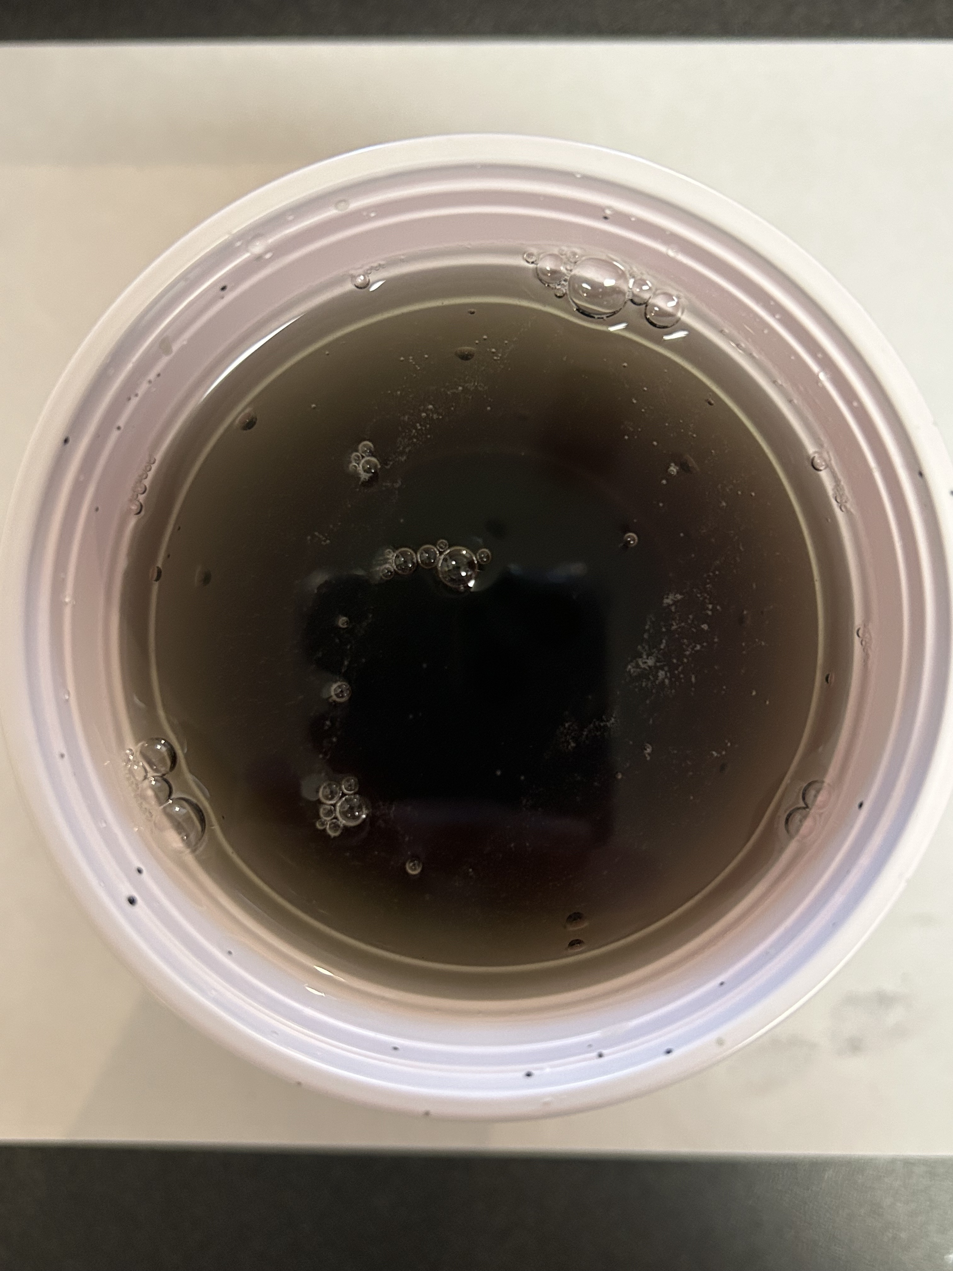
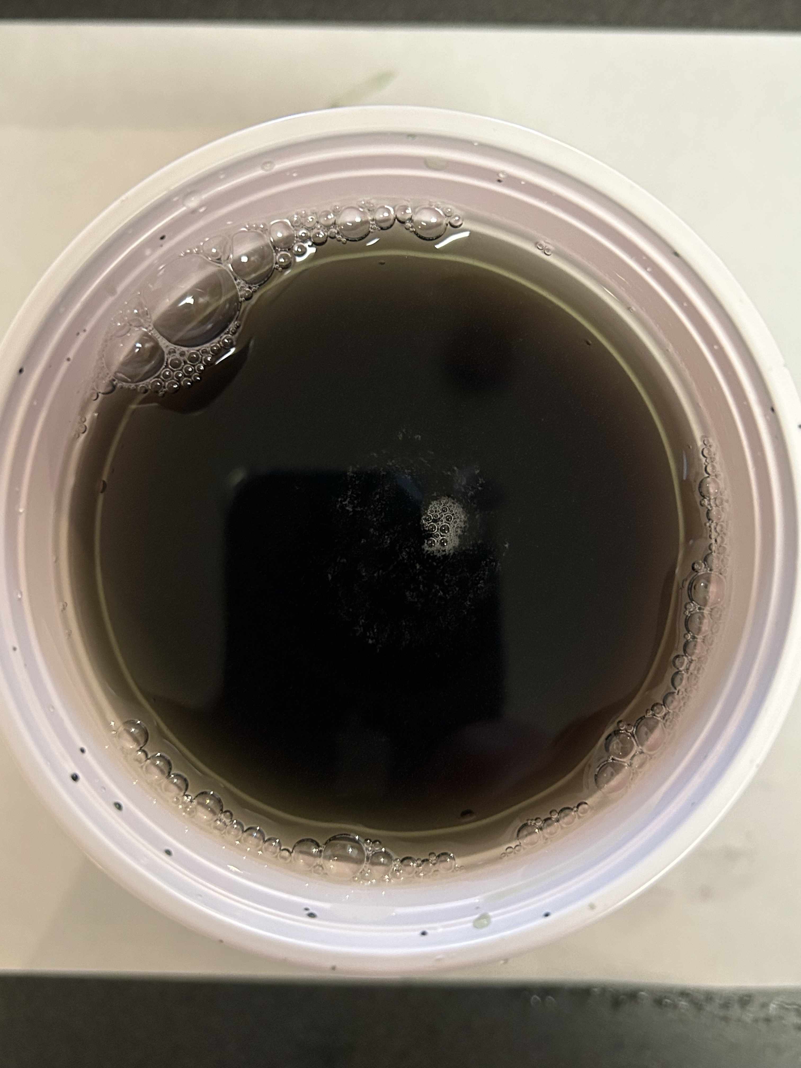
Step 3: Taking Photos
1. Taking Photos
Do your best to take photos of the water directly
Minimize glare and shadows
Write the sample number on a white sheet of paper and place under the sample for the photo
2. Transfer photos directly to your computer or upload to the Google drive using the QR code!
Download at: http://tinyurl.com/MendotaPhotoUpload
3. If you are unable to take photos, find photos at http://tinyurl.com/MendotaRSLesson

Slide 13
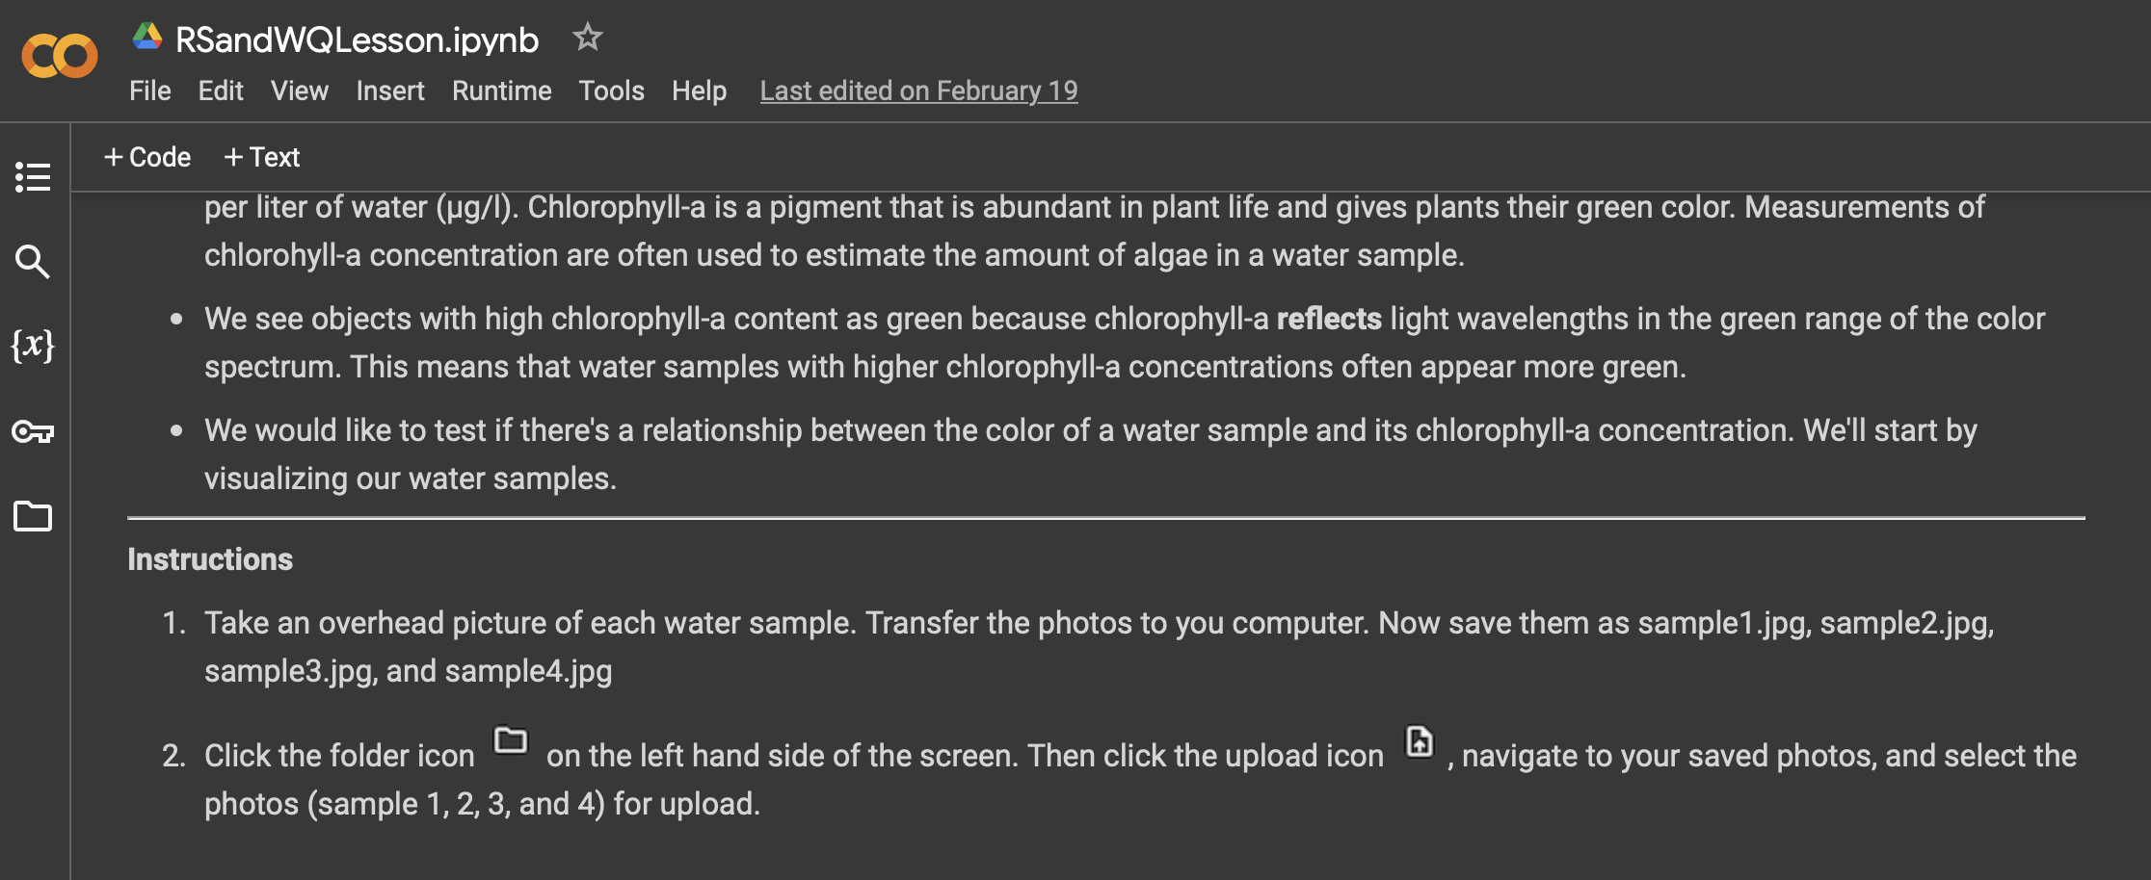
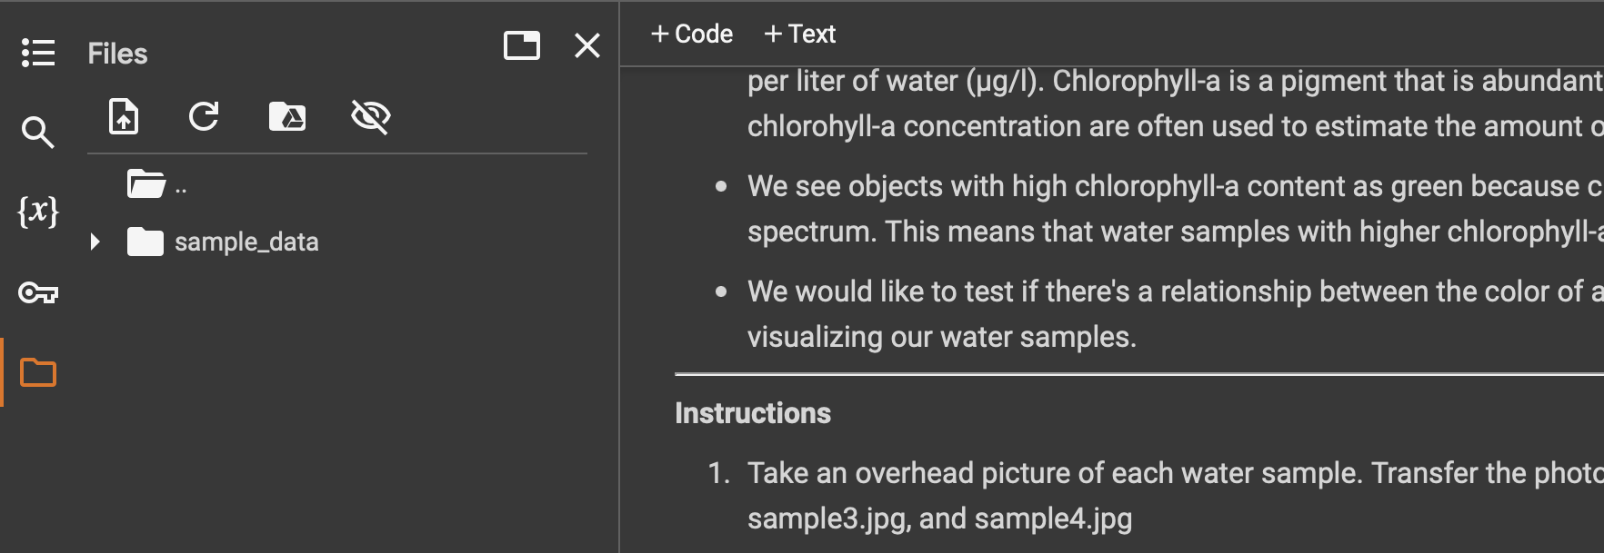
Step 4: Upload photos to the worksheet
Note: photos must be in .jpeg or .jpg format
Sample pictures should be named:
sample1.jpeg: 1.5ml sample
sample2.jpeg: 3 ml sample
sample3.jpeg: 15ml sample
sample4.jpeg: 25ml sample
Open the folder icon
Open the folder icon

Slide 14
Running the model code
Run code for Part 1: Read in image data and investigate image bands
Consider the questions
Discuss
Run code for Part 2 + 3: Statistical modeling of chlorophyll-a
Download the MendotaImage.tif file, and reupload for the last section
Consider the questions
Discuss

Slide 15
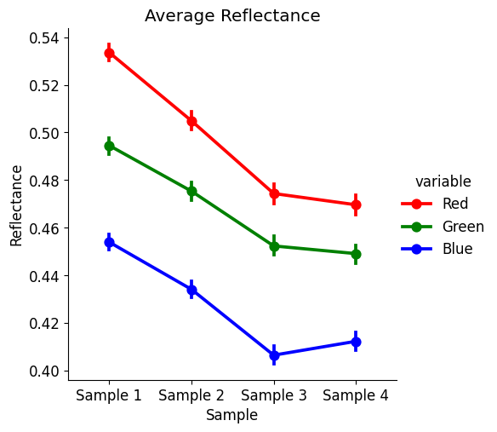
Part 1: Read in image data and investigate image bands
Q1: Which areas of the image appear to have the highest reflectance values? Why do you think that is?
A1: The white areas of the cup and the paper have the highest reflectance values. This is because white objects reflect all light. It is difficult to tell differences in reflectance between in the water between images.
Q2: How do reflectance values for each band change between samples?
A2: All bands decline from sample 1 to sample 4.
Q3: Which bands change the most and which change the least? Why do you think this is?
A3: Reflectance of the red band declines the most between sample 1 and sample 4. This suggests that more red light is being absorbed by water with a higher concentration of algae. The green band doesn’t appear to change as much as the red and blue bands. This might be because the water is getting darker with more chlorophyll, and not greener.
Q4: Are these results what you expected? Why or why not?
A4: No, we expected green reflectance to increase with more chlorophyll, but it is decreasing. Red and blue are also decreasing, which was expected.

Slide 16
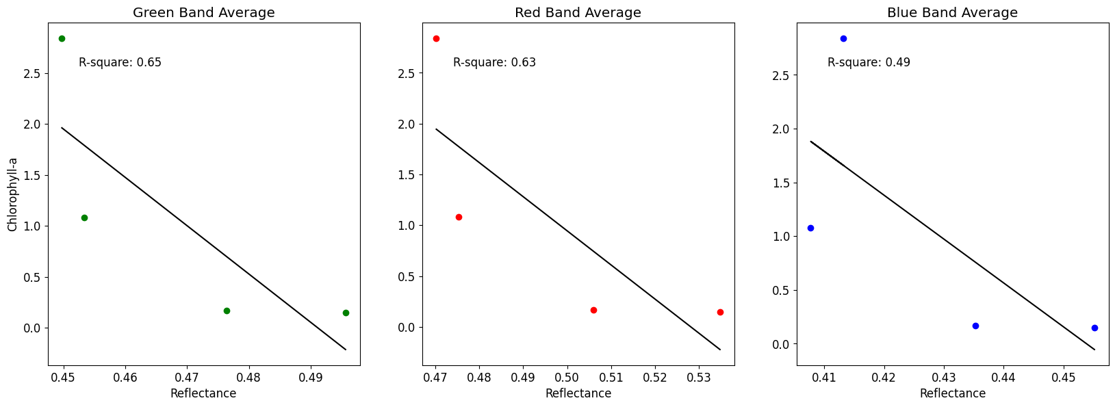
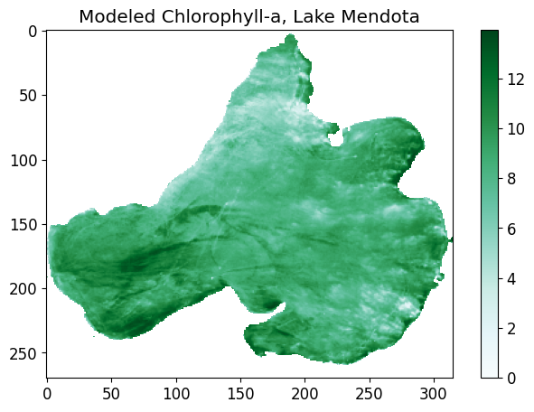
Part 2: Statistical Modeling of chlorophyll-a
Q5: Based on R-squared, which model best predicts chlorophyll-a? (R2 score closer to 1 = better model)
A5: The green band model performs the best, followed closely by the red band model.
Q6: Using your background knowledge, which model makes the most sense to use?
A6: We hypothesized that the green band reflectance would increase with chlorophyll content. The model performs well, but the relationship between green reflectance and chlorophyll is decreasing. Because the relationship between chlorophyll and the red band makes more physical sense, we choose to use the red band model.
Part 3: Model Application
Q7: Which areas of Lake Mendota appear to have the highest chlorophyll-a?
A7: Chlorophyll looks highest in the western bay of Lake Mendota and along shorelines.
Q8: What are some limitations of this approach to estimating chlorophyll-a?
A8: The model only relies on one imagery band. Model results might be biased by other things in the water that are interacting with light (plants, shoreline, etc.)

